Slide 1
PROJECT TITLE
CAPSTONE PROJECT
Student Name : Aayushi R
College Name & Department : btech- cse cybersecurity

Slide 2
OUTLINE
Problem Statement
Technology used
Wow factor
End users
Result
Conclusion
Git-hub Link
Future scope

Slide 3
Problem Statement
With increasing cybersecurity threats, sensitive data transmission is at risk. Traditional encryption methods can attract attention, making data interception likely. Steganography offers a covert way to embed secret messages within images without raising suspicion. This project implements Least Significant Bit (LSB) steganography to securely hide text in images while maintaining their visual integrity.

Slide 4
Technology used
Programming Language: Python
Libraries: OpenCV, NumPy, Pillow
Concept: LSB (Least Significant Bit) technique for embedding text

Slide 5
Wow factors
gui interface
easy to add messages

Slide 6
End users
Who are the end users

Slide 7
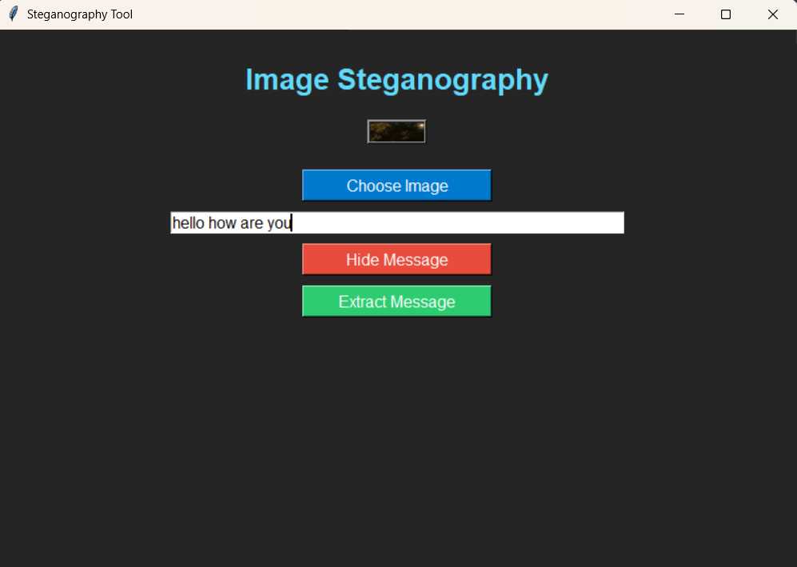
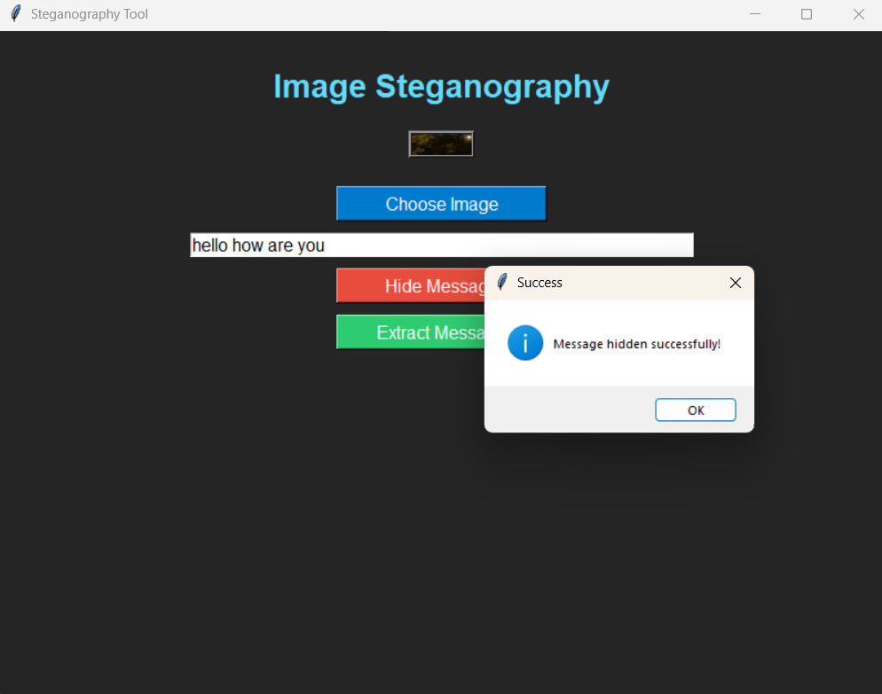
Results
saving file with hidden message
choosing image to hide text in and writing the message

Slide 8
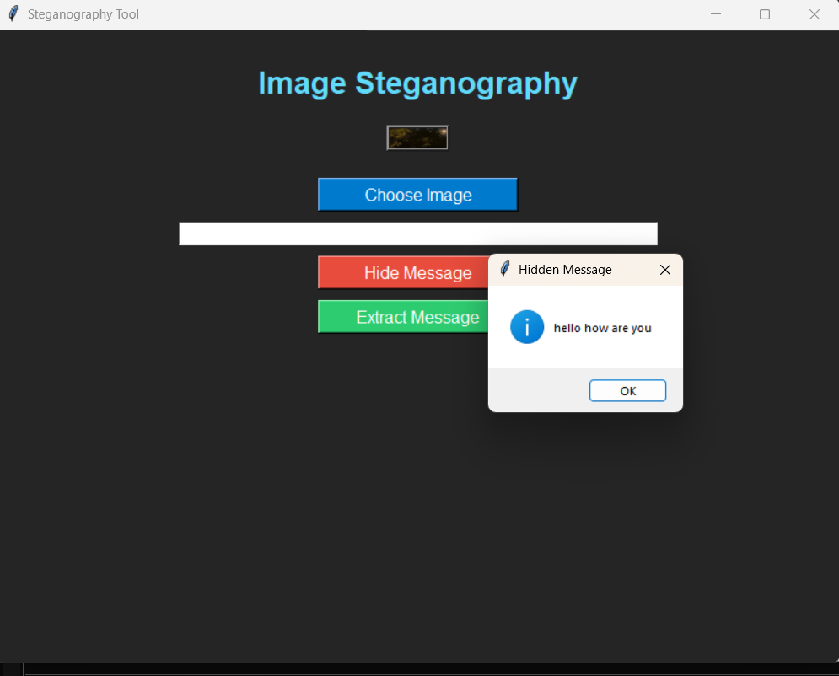
extracting message after opening saved file with message.

Slide 9
Conclusion
This project successfully demonstrates how steganography can be used to securely hide text within images, ensuring confidential communication without raising suspicion. By implementing the Least Significant Bit (LSB) technique, the hidden data remains imperceptible to the human eye. This approach has applications in cybersecurity, digital forensics, and privacy protection. Future improvements can integrate encryption for enhanced security and expand usability through mobile or web applications.

Slide 10
GitHub Link
Make sure that there should be readme file

Slide 11
Future scope(optional)
Enhancing security by combining steganography with encryption.
Applying deep learning to improve steganalysis resistance.

Slide 12
THANK YOU

